Slide 1
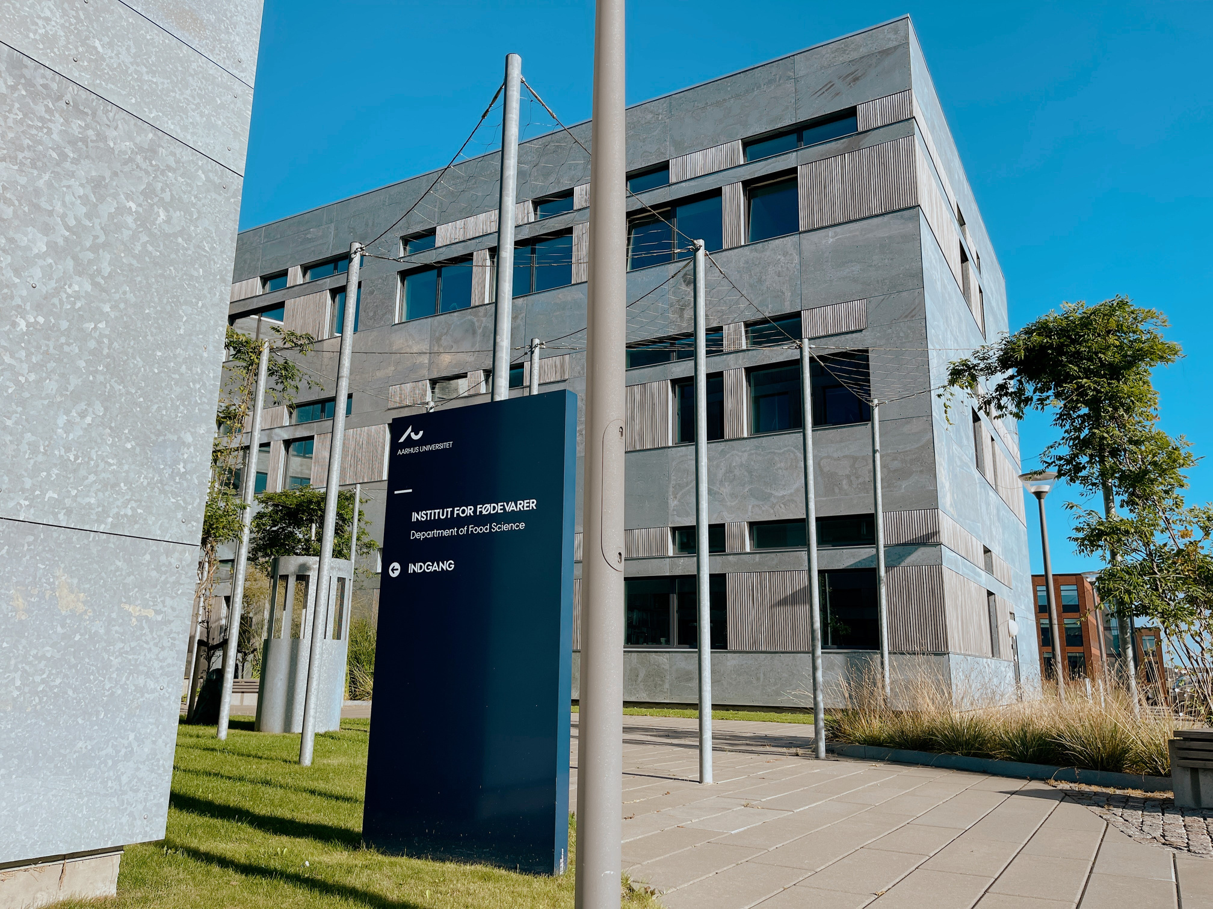


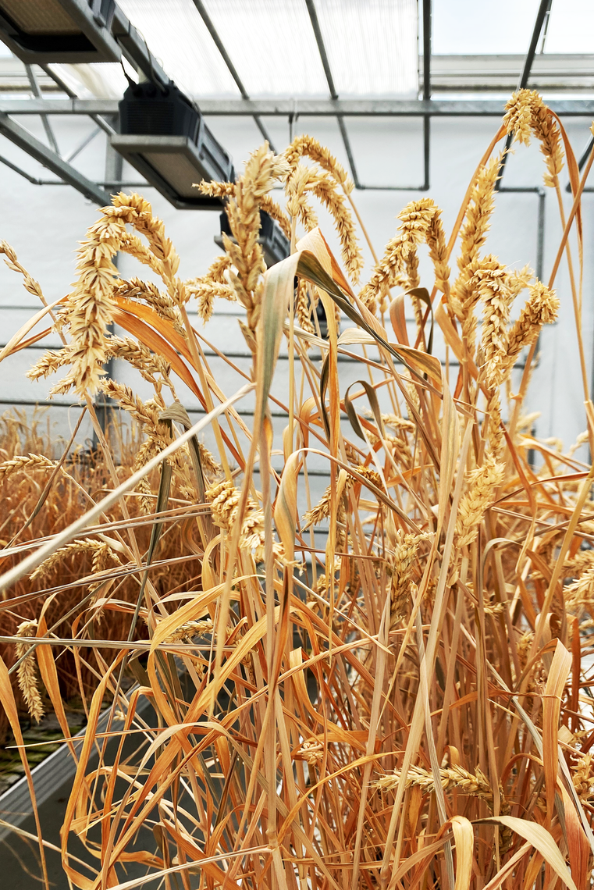
PRESENTING
THE DEPARTMENT
OF FOOD SCIENCE
The Department of Food Science, Aarhus University
Agro Food Park 48
8200 Aarhus N

Slide 2

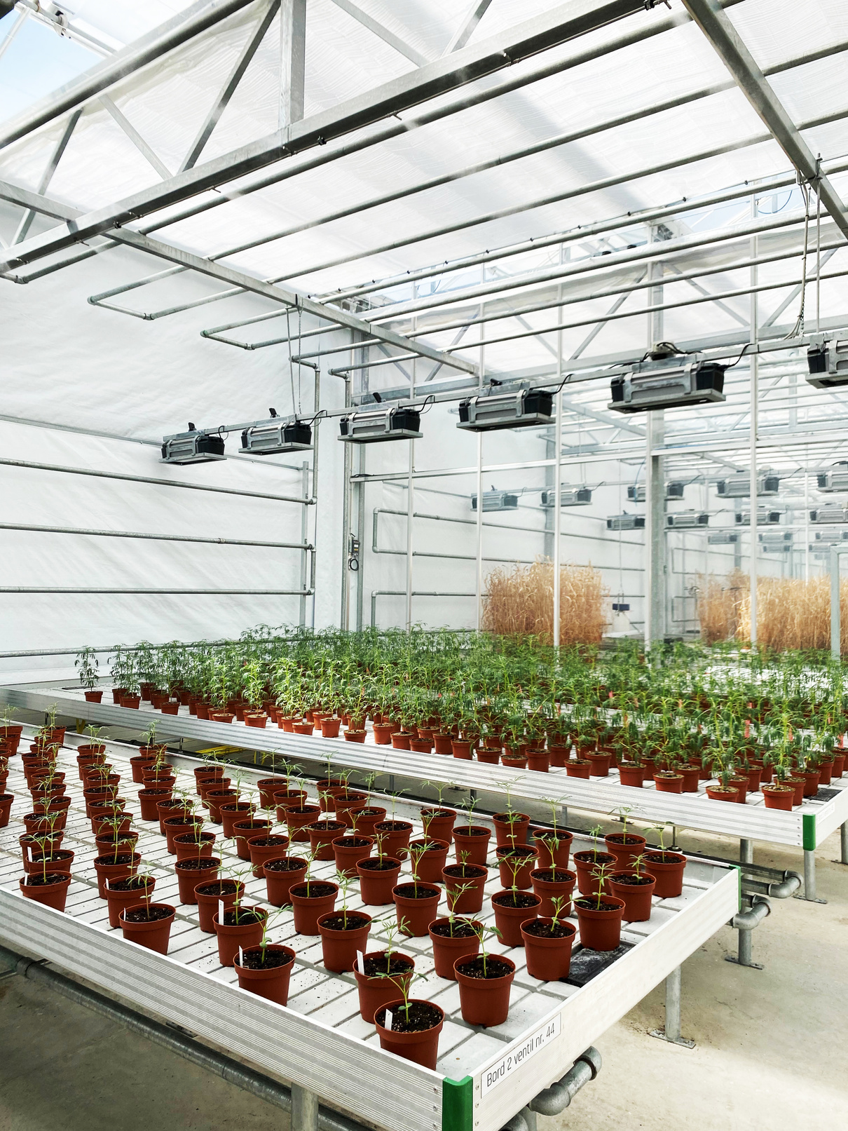

INTRODUCING AU FOOD: 🌱 THE PROFILE
AU FOOD conducts basic, strategic, and applied research across the full spectrum of food science. Research spans from the production and quality of raw materials such as fruit, vegetables, meat, and dairy to packaging, sensory analysis, and food chemistry. Through its work, the department contributes to the development of innovative solutions that support public health, sustainability, and food safety through research, consultancy, and teaching.

Slide 3
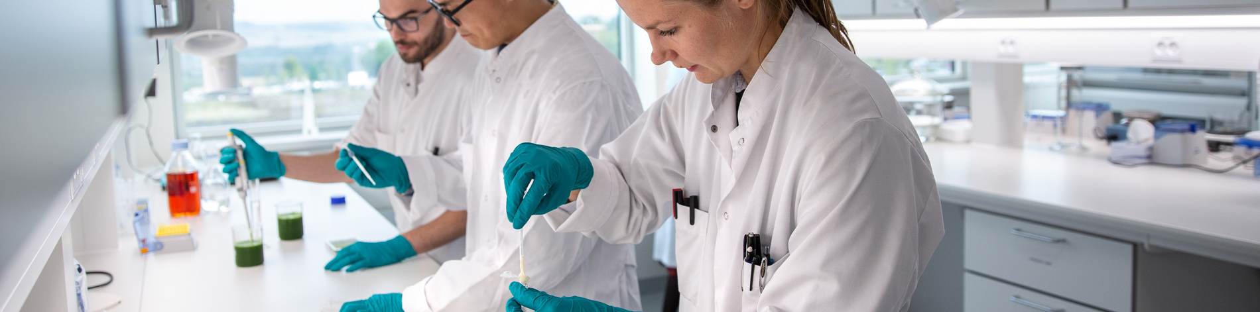
ABOUT US
Vision, People & Expertise
The department aims to be among the leading international institutions in food science, committed to creating and translating cutting-edge knowledge for the benefit of society both nationally and globally. AU FOOD is home to multiple research groups, advanced laboratory facilities, pilot-scale processing equipment, and a central administrative unit. Dedicated scientists and technical staff engage in areas ranging from food composition and quality to sensory evaluation and innovative approaches to packaging and storage.
The department also plays a key role in education, contributing to programmes such as the BSc in Agrobiology, MSc in Food Chemistry, MSc in Food Technology, and other international partnerships.

Slide 4
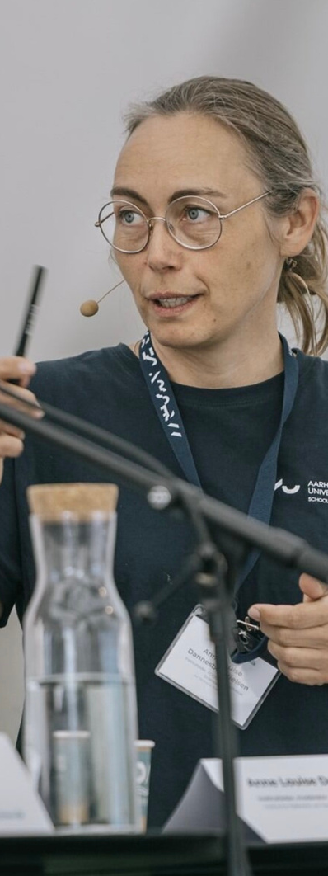

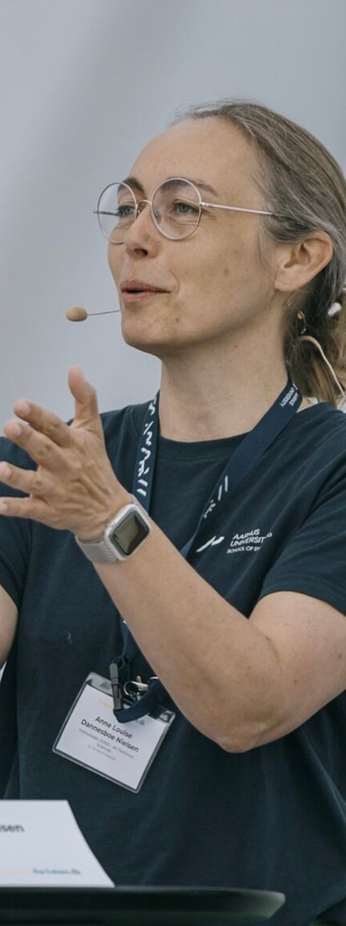
INTRODUCING OUR HEAD OF DEPARTMENT
Anne Louise Dannesboe Nielsen leads the Department of Food Science (AU FOOD) at Aarhus University with a strong focus on research excellence, collaboration, and societal relevance. With a background in leadership at Teknologisk Institut, and plenty of experience in working across both academia and management, she brings strategic vision and a deep understanding of how food, sustainability, leadership and innovation intersect. Under her leadership, AU FOOD continues to foster interdisciplinary research, international partnerships, and impactful dialogue on the future of food systems.

Slide 5
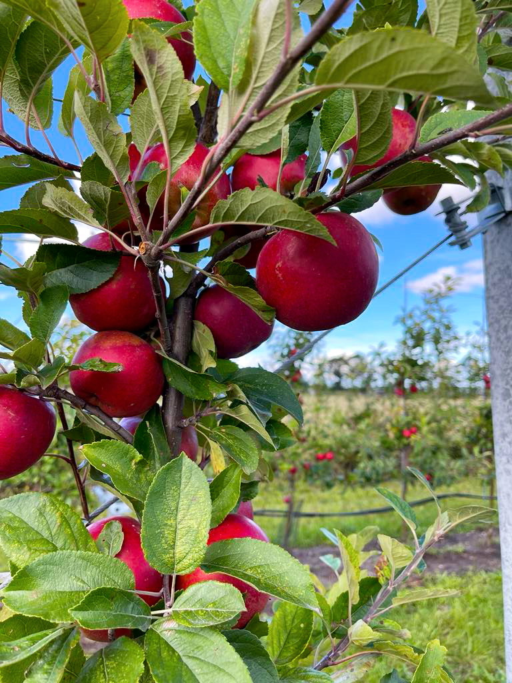
AU FOOD has its roots in Denmark’s long-standing tradition of agricultural and food research. Originally part of the Faculty of Agricultural Sciences, the department became an independent unit under Aarhus University in 2007 following a major university merger. Since then, AU FOOD has grown into a leading research environment focused on the entire food value chain — from raw material quality and processing to packaging, sensory science, and food chemistry.
OUR HISTORY
2007-2011
2011
2011-2019
2019 - present
Two departments: Food Science & Horticulture (academic activities)
AU FOOD is formed - two campuses. Faculty of Science & Technology.
Planning of relocation process, building, and moving location.
AU FOOD became part of the current Faculty of Technical Sciences.

Slide 6
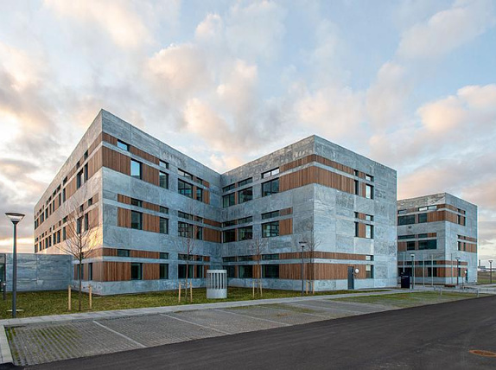
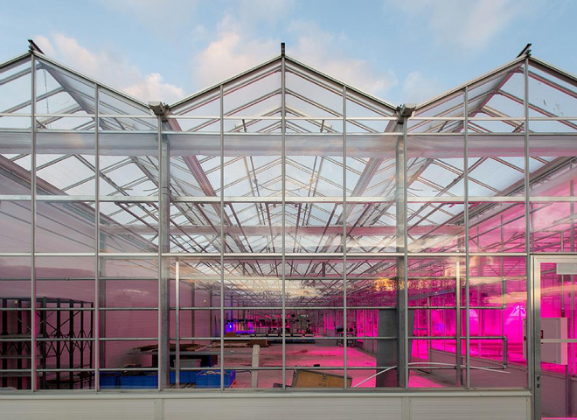
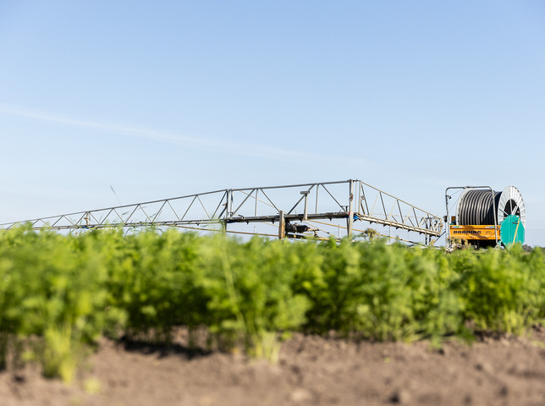
OUR FACILITIES
AGRO FOOD PARK
THE GREENHOUSE
FIELD STATION IN AUNING
Located in Agro Food Park in Aarhus N, The Department of Food Science has it’s main building, offices and labs here.
At the main building in Agro Food Park, we have extensive greenhouse facilities to do controlled tests, trials and experiments.
In Auning, we have our beloved 91 acres field station with it’s very own staff, where we make real-time research under realistic and controlled field-trials.

Slide 7
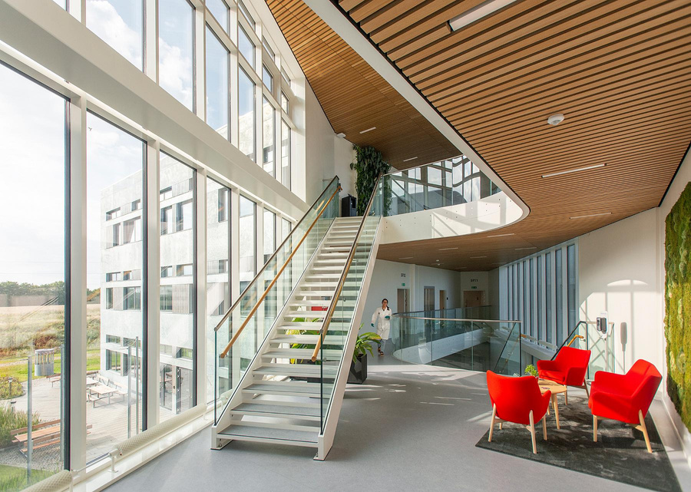
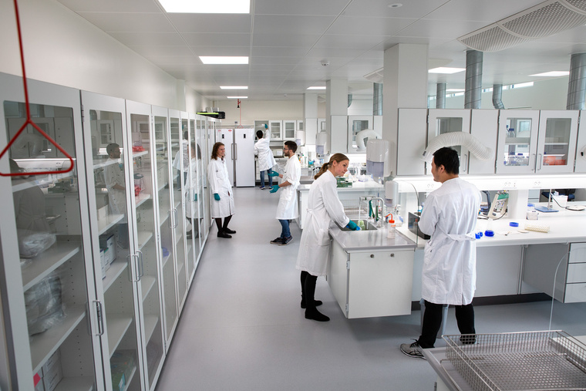
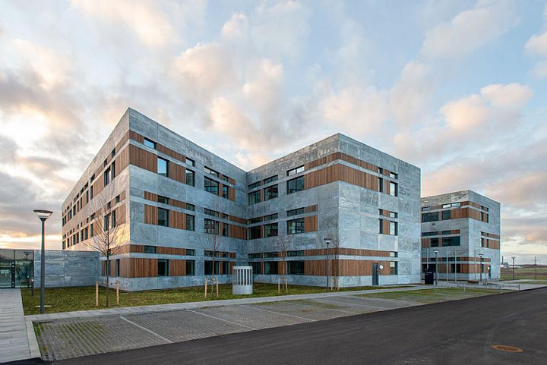
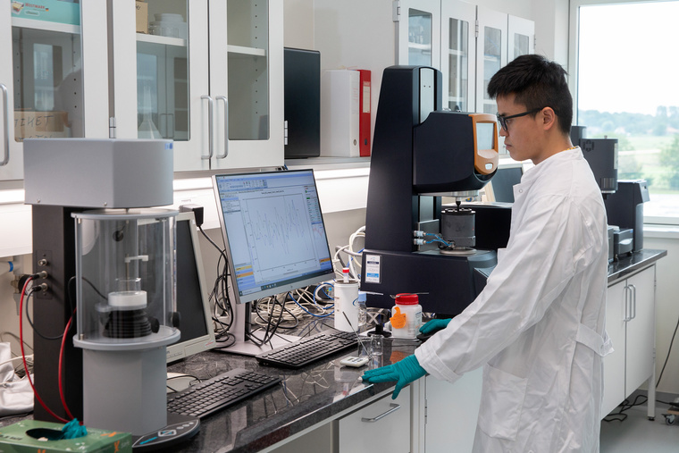
🧪 AGRO FOOD PARK
AU FOOD’s location at Agro Food Park places it at the heart of Denmark’s leading food innovation cluster. Surrounded by industry partners and startups, the facilities support cutting-edge research and collaboration.
🔬 Key Facilities
Advanced Labs: Mass spectrometry, NMR, and metabolomics platforms
Pilot Plant: Processing technologies and food structure analysis
Sensory & Health Labs: Research on taste, nutrition, and consumer experience
Climate-Controlled Growth Areas: Glasshouses and climate chambers for plant studies
Postharvest Tech: Equipment for drying, grading, and storage
This strategic location strengthens AU FOOD’s impact on sustainable food systems and innovation.

Slide 8
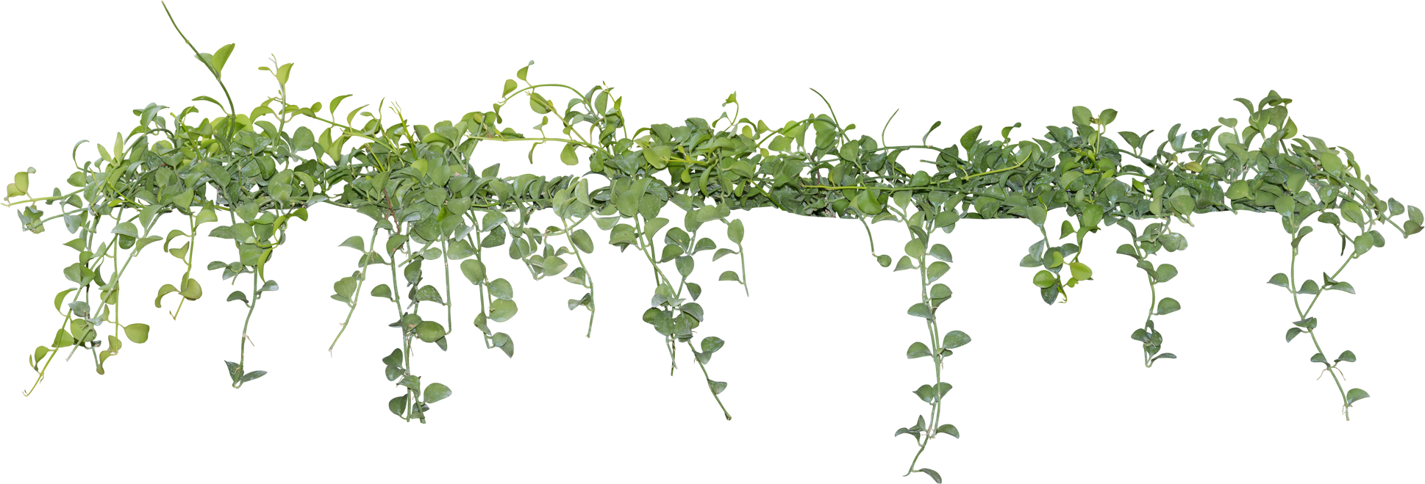
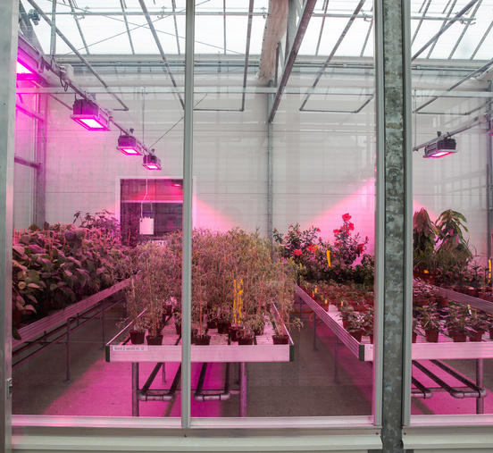
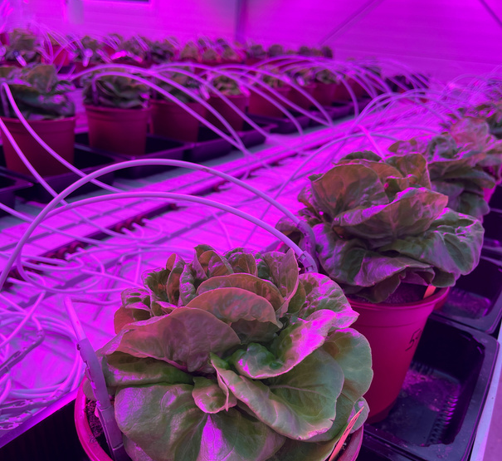
🌿 THE GREENHOUSE
AU FOOD’s 2,500 m² greenhouse is a cutting-edge facility for plant research, designed to simulate future climate conditions and optimize crop resilience.
🌱 Key Features
13 Climate-Controlled Rooms: Twelve 48 m² units and one 200 m² space
Growth Simulation: Adjustable light, oxygen, humidity, water quality, and nutrients
Advanced Research: Studies on photosynthesis, phenotypes, and frost tolerance
Biofarm Potential: Enhancing plants to produce high-value natural ingredients
This greenhouse enables AU FOOD to explore sustainable farming, improve food security, and develop crops for tomorrow’s challenges

Slide 9

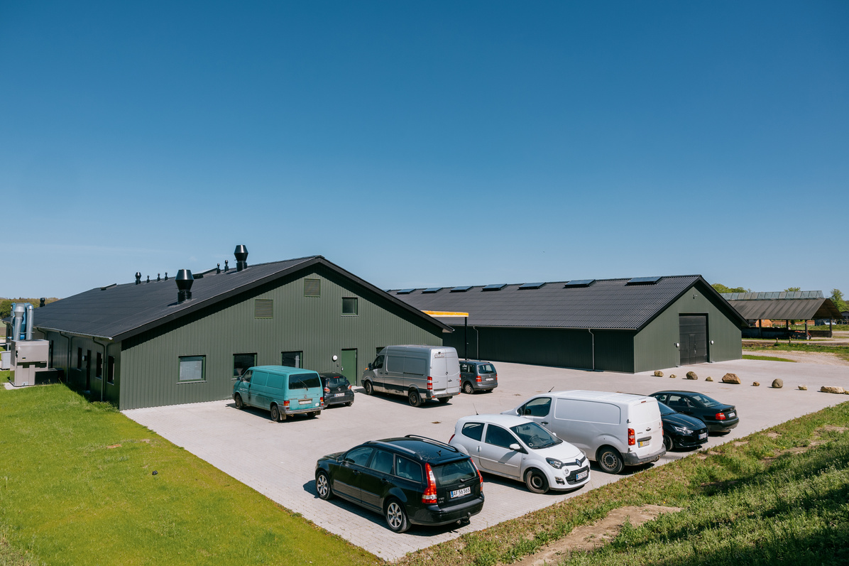
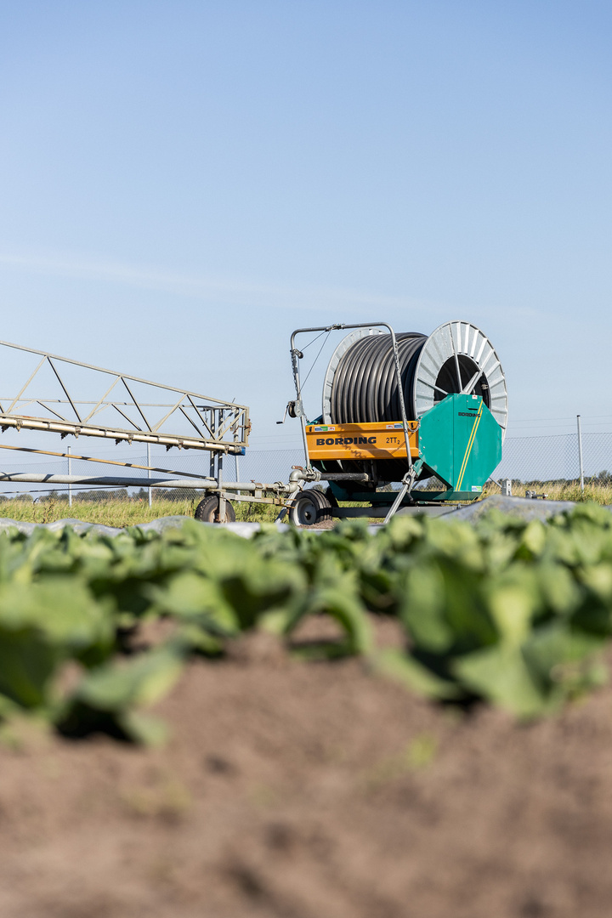
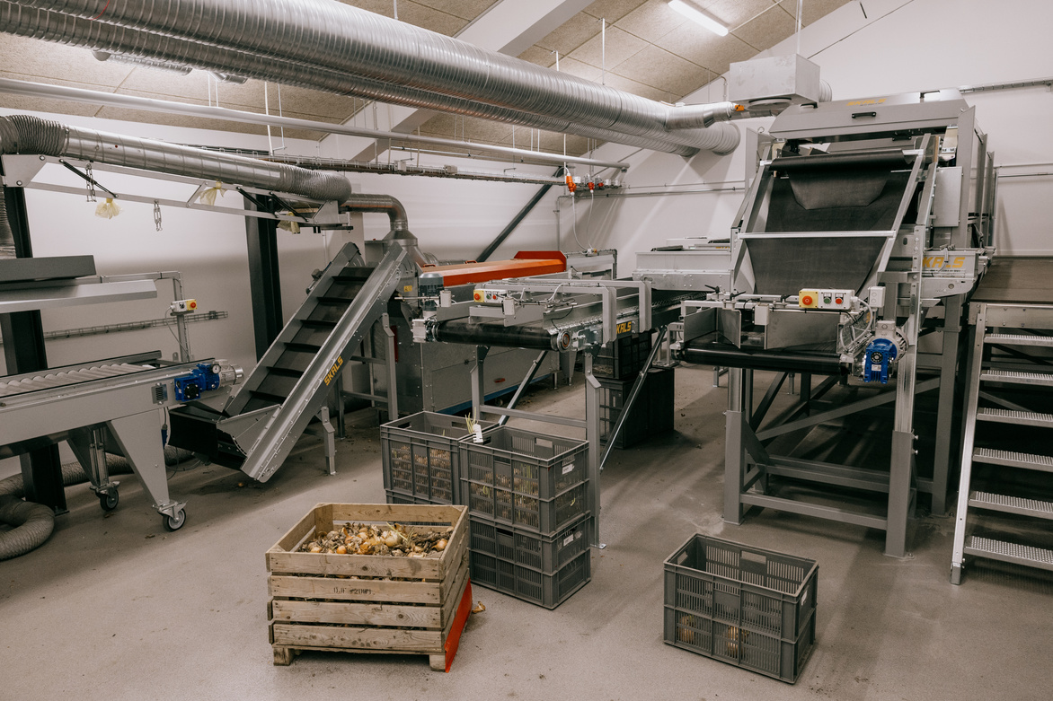
🌾 FIELD STATION IN GL. ESTRUP, AUNING
AU FOOD’s field station at Gl. Estrup is a cornerstone for sustainable crop research, offering 40 hectares of land and 2,000 m² of lab space dedicated to fruit, vegetable, and plant-based food innovation.
🌱 Key Highlights
Large-Scale Field Trials: Research on organic apples, legumes, and vegetable cultivation
Sustainable Practices: Focus on compost, plant-based fertilizers, and climate-friendly farming
Clonal Collections: Preservation and study of over 100 plant varieties like rabarber, humle, and skalotteløg
Strategic Location: Close collaboration with Det Grønne Museum and Agro Food Park
This station strengthens AU FOOD’s commitment to future-proofing agriculture and developing resilient, eco-friendly food systems.

Slide 10

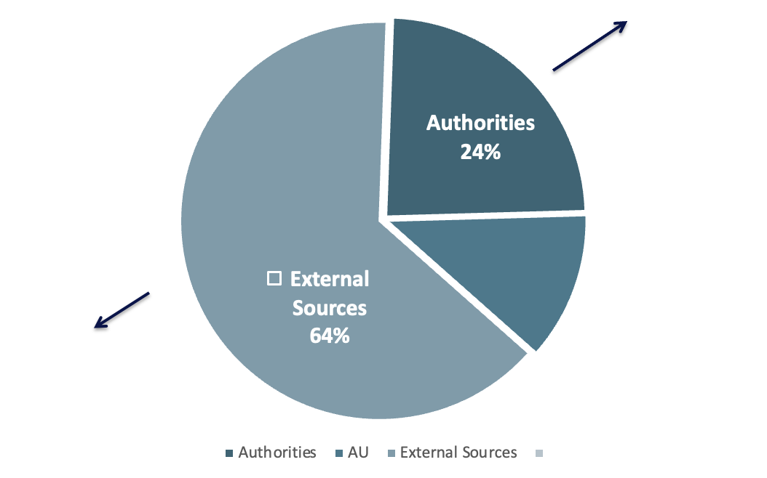

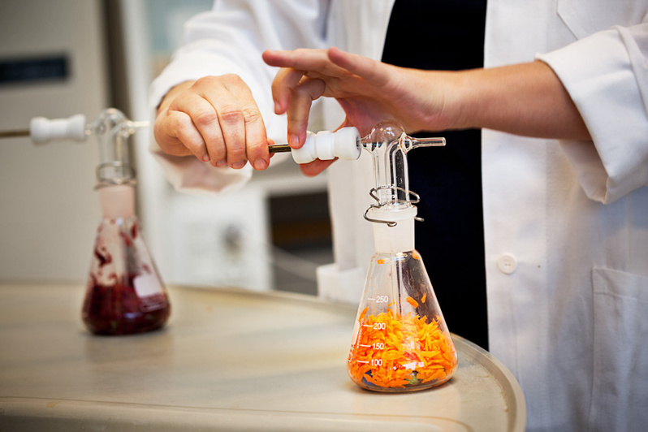
​Policy advise to Ministries:
​- Within the framework of DCA – Danish Centre
For Food and Agriculture:
​- AU FOOD provides research-based policy advice mainly to the Ministry of Food, Agriculture and Fisheries, Denmark
FUNDING (2023)
Externally funded projects: Private and public national and international funding sources

Slide 11
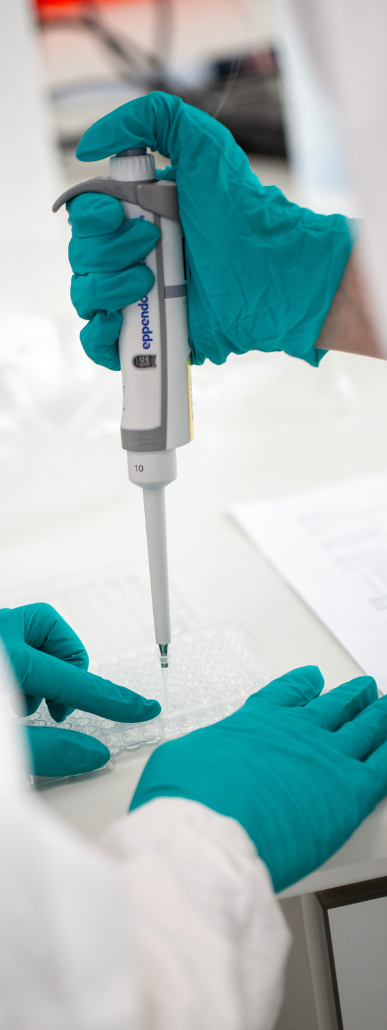
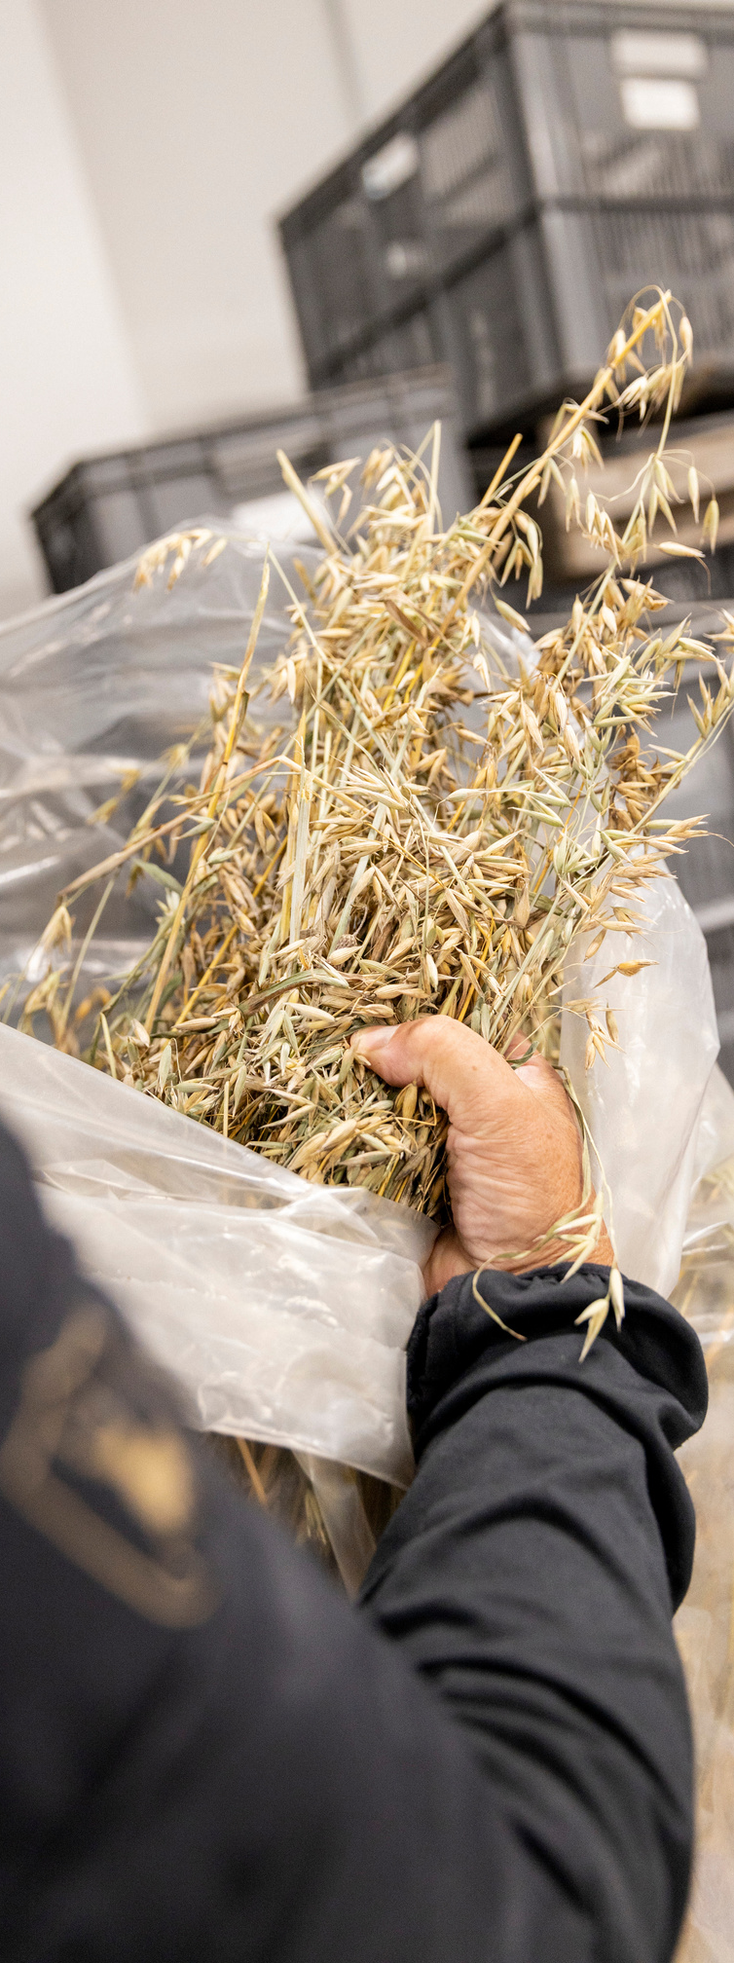
🤝 COLLABORATIONS
Education:
30-40% of BA and MSc theses with industrial co-supervision
5% of Ph.D. theses with industrial co-supervision
34% of Ph.D. thesis with co-supervision outside AU FOOD
Strategic collaboration agreements:
With WUR (2023) and INRAE (2024) by AU TECH Faculty. Joint initiatives and EC positioning in the food & horticulture areas
Arla Food for Health program: Public-private partnership & AU-Arla strategic alliance, joint Ph.D.s etc.
EIT FOOD HEU Pillar III: The world’s largest food innovation ecosystem, >100 partners, FOOD 52 projects in innovation, business, education, public engagement
CIRCUL-A-BILITY HEU COST-Action: Rethinking food packaging, 45 countries
FOODHAY National Research Infrastructure Roadmap: 5 research & industrial partners, food and health RI of 13.7 M Euros

Slide 12
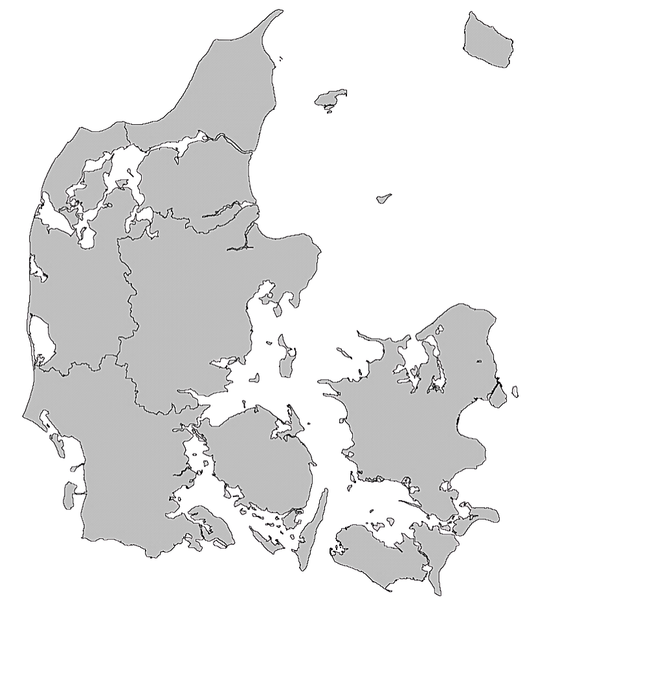



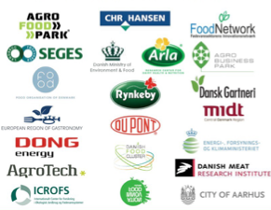
Research partners:
Associated employees:
EXAMPLES OF NATIONAL COLLABORATION PARTNERS
Examples of Danish collaboration partners & initiaves:

Slide 13



International collaboration partners/initiatives:
EXAMPLES OF INTERNATIONAL COLLABORATORS
Associated employees:
International research partners:

Slide 14
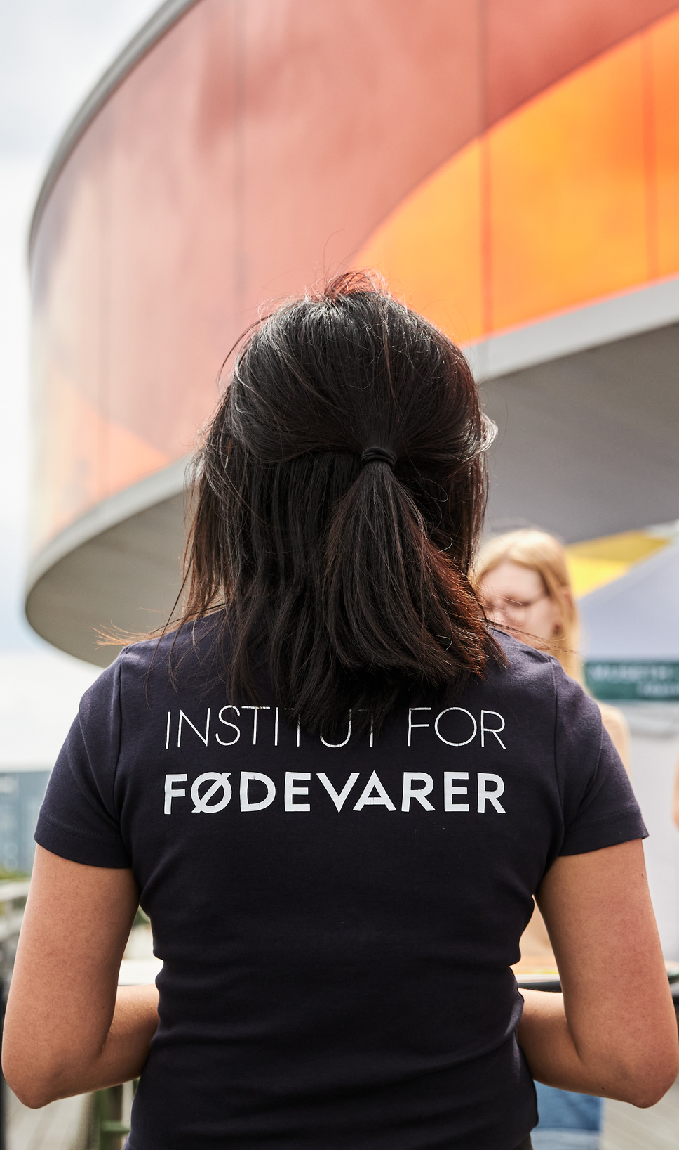
OUR VISION
01.
02.
AU FOOD will be recognized nationally and internationally for delivering high impact research, and leading talent in food science. We will be a preferred partner for new initiatives based on our research expertise and collaborative approach.
We will deliver a positive impact for the food industry and society through research talent development and innovation in food solutions. We will secure a sustainable and inspiring working environment in the Department.

Slide 15
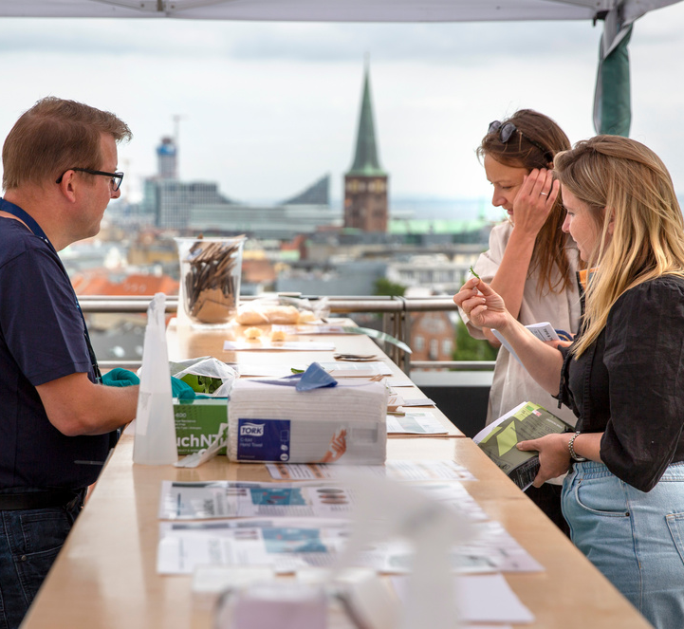
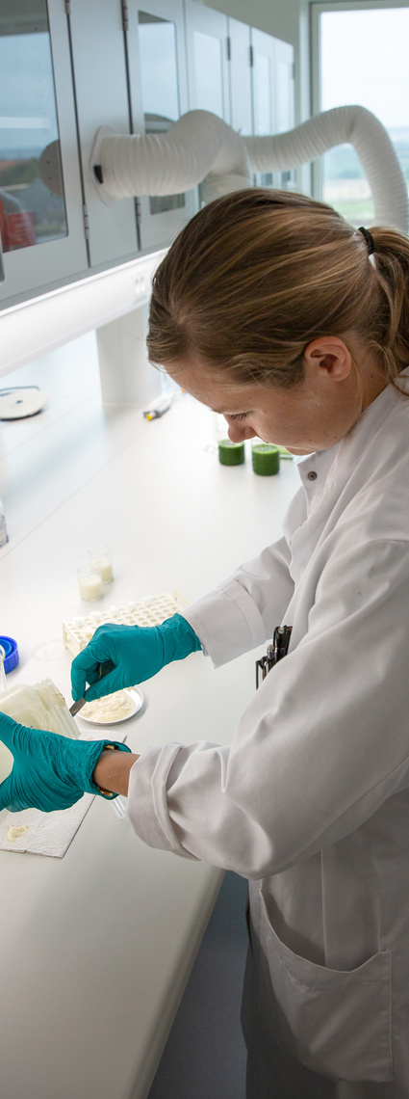
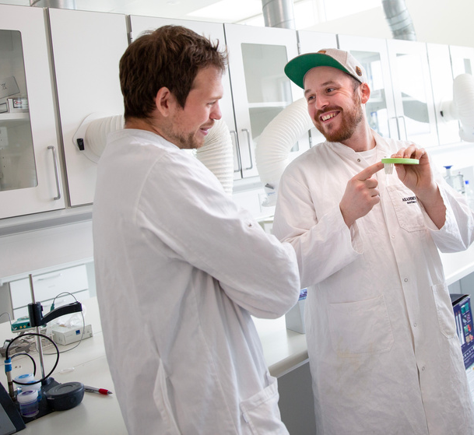
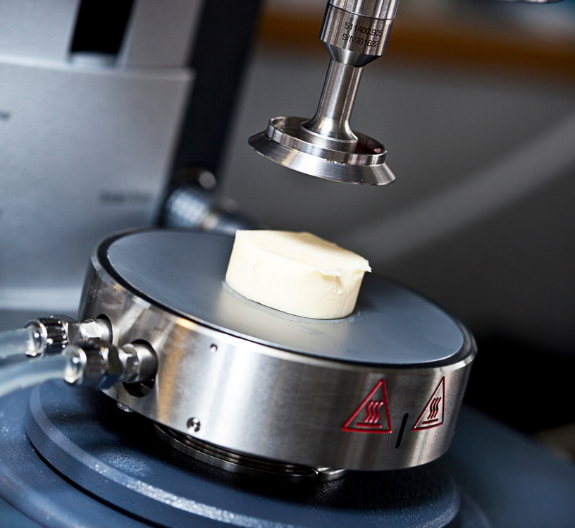
OUR MISSION
01.
Continue promoting interdisciplinary research and collaboration in food science. 98% of projects in FOOD are collaborative!
02.
Working from a focus on four strategic research themes:
1) Plant, Food & Environment
2) Climate-friendly Foods
3) Circularity & Food Waste
4) Food, Health & Well-being
03.
Doing research in the entire value chain with diverse funding sources that supports real-world impact.

Slide 16

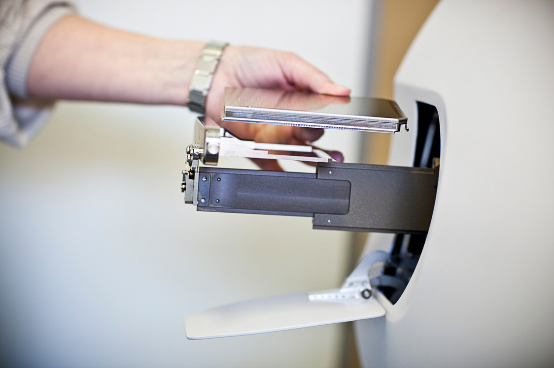
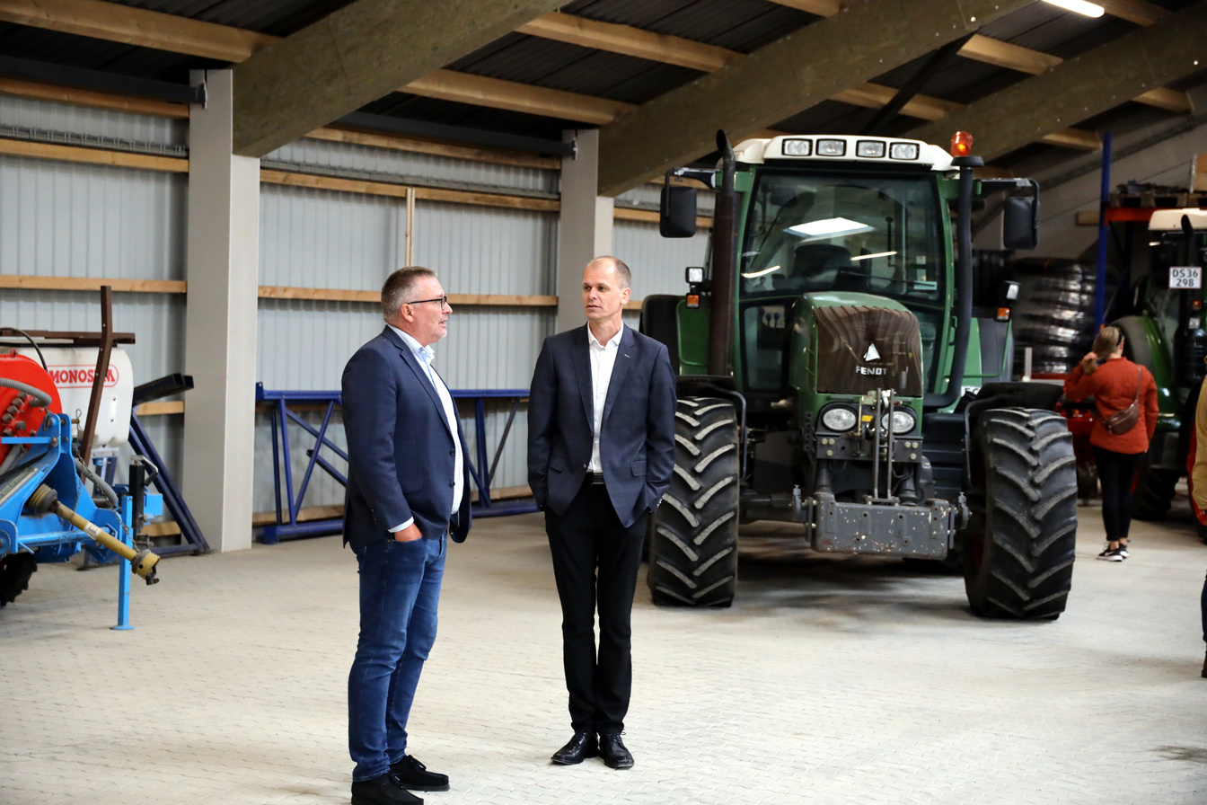
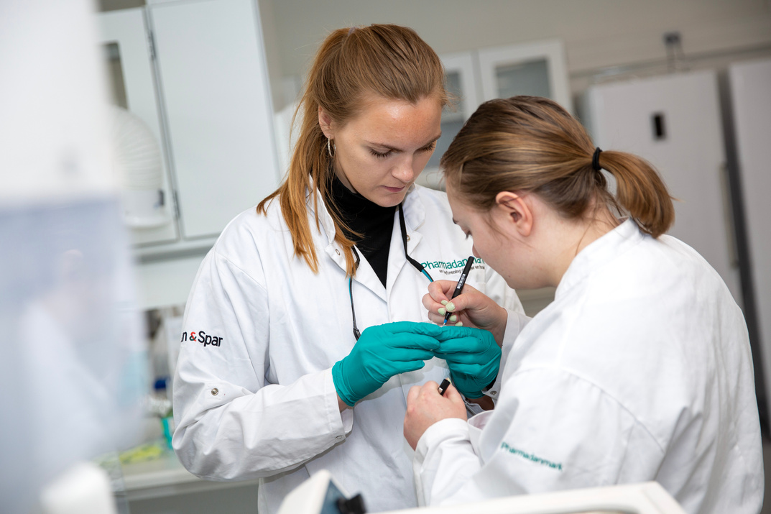
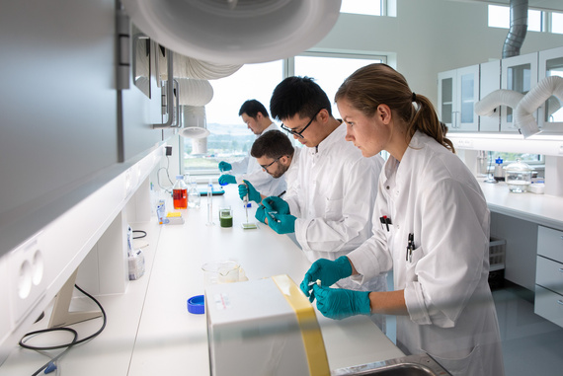
OUR STRONGHOLDS
Interdisciplinary research
Influence
Interdisciplinary research with research in the entire value chain.
Direct influence on policy makers, policy creation and legislation through DCA policy advise activities.
Collaboration
Diversity
Collaboration with small, medium and large companies, organizations and policy actors in >90% of projects.
5 affiliated industrial Assoc. Prof.
2 academic & 1 industrial affiliated Professors
Diverse funding sources
Staff diversity w. 51% non-Danish scientific staff from 27 countries
Approx. 60% women, incl. leadership roles
English is the main language in FOOD

Slide 17

HEAD OF DEPARTMENT
Anne Louise Dannesboe Nielsen
OUR STRUCTURE
HEAD OF SECRETARIAT
FUNDRAISER
Stella Spanou & Asger Schmidt-Jensen
Annette Visti
From Head of Department to key strategic roles & Science Team Leaders
SECRETARIAT
SCIENCE COMMUNICATOR
AU FOOD is built around key strategic roles that oversee each of their specific areas of expertise in the Department, ensuring high-quality management and improved work-flow within and between all fields.
Staff
Kimie Kongsøre
PLANT, FOOD & SUSTAINABILITY
DIFFERENTIATED & BIOFUNCTIONAL FOODS
FOOD TECHNOLOGY
FOOD QUALITY, PERCEPTION & SOCIETY
FOOD CHEMISTRY
Hanne Lakkenborg Kristensen
Lars Wiking
Marianne Hammershøj
Jette Feveile Young
Derek V. Byrne

Slide 18
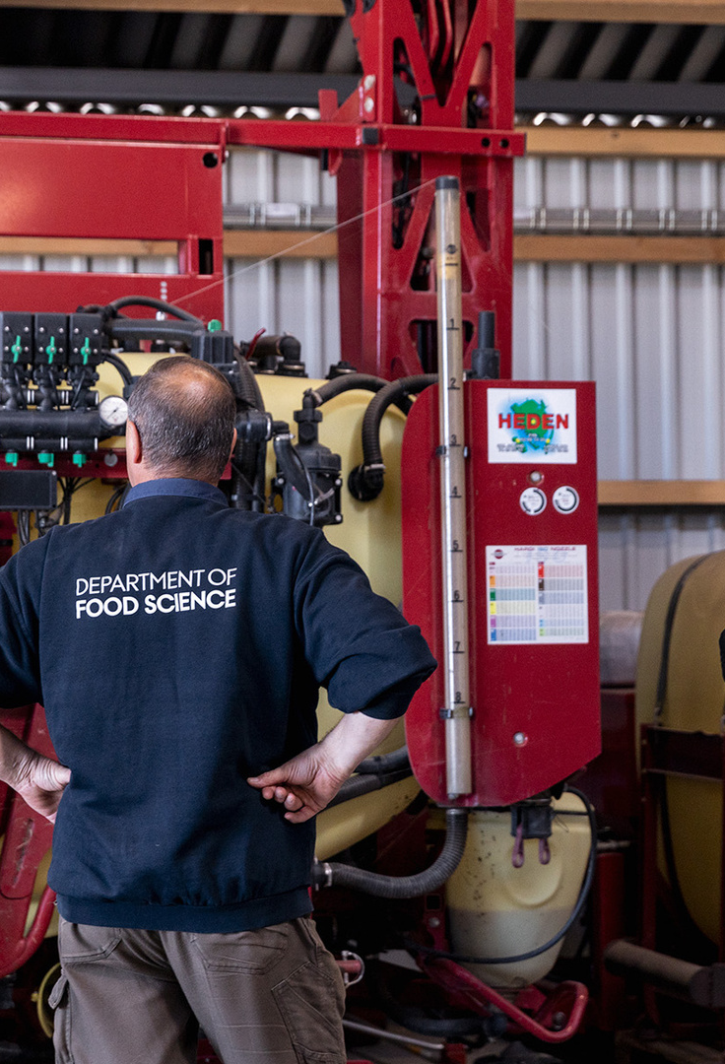






OUR EMPLOYEES
AT THE DEPARTMENT OF FOOD SCIENCE
Senior scientists / Assoc. Prof. / Prof. / HOD
Assist. Prof. (tenure track) & Post Docs
PhD Students
Academic-technical staff incl. fundraiser & science communicator
Technical staff (varies pr.year)
Secretarial staff

Slide 19
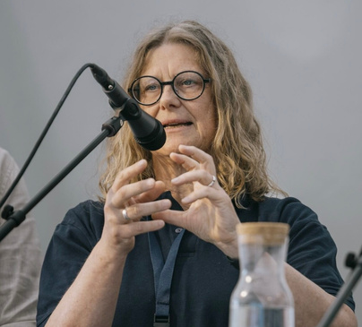
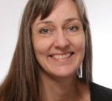
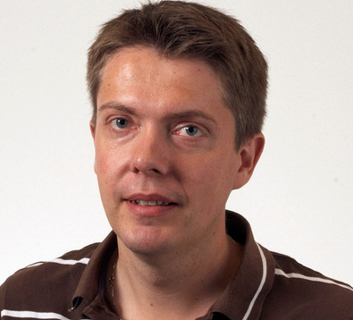
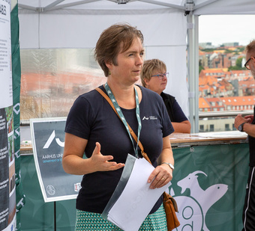

MEET OUR SCIENCE TEAM LEADERS
Each responsible for their very own research area and team, our Science Team Leaders are key figures in how we organize our research and work at the Department of Food Science.
Jette Feveile Young
Marianne Hammershøj
Lars Wiking
Hanne Lakkenborg Kristensen
Derek Victor Byrne
Differentiated & Biofunctional Foods
Food Technology
Food Chemistry
Plant, Food & Sustainability
Food Quality, Perception and Society

Slide 20
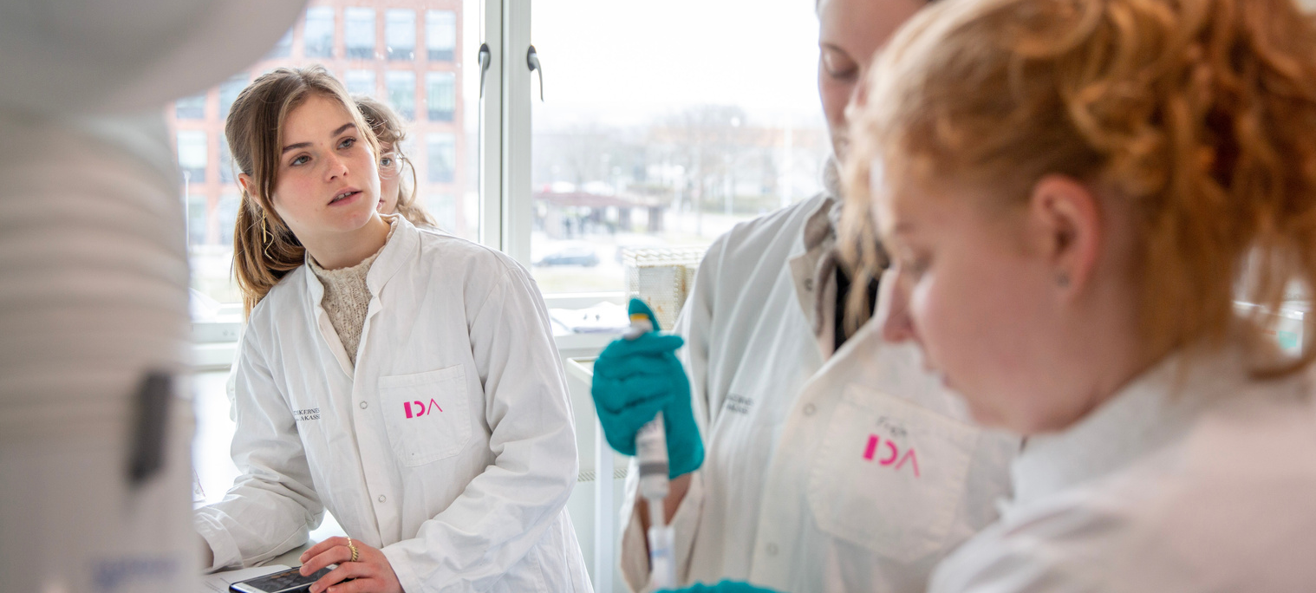
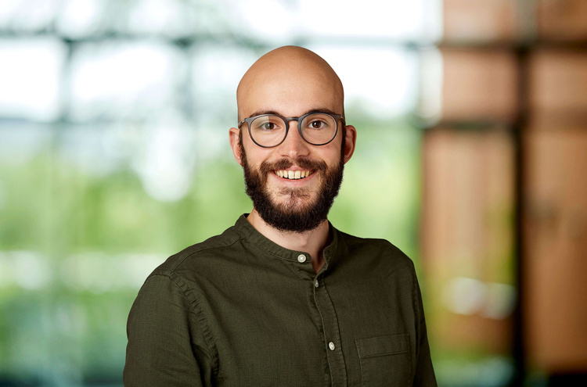




Or reach out to our fundraisers & business developer, Asger Munch Smidt-Jensen, at:
CONTACT US
Interested in reaching out, collaborating or just getting to know us even better? Please contact us using the information below:
+45 87 15 60 00
www.aufood.dk
+45 20 96 25 41
food@au.dk
asje@food.au.dk
Agro Food Park 48, 8200 Aarhus N
Agro Food Park 48
Build. 5911-228
8200 Aarhus N

Slide 21

PROFILE
THANKS FOR
WATCHING
🌱 AU FOOD – It’s all about food and food science.

